Slide 1
RAL Staging Servers
Rob Applin
Oak Ridge National Laboratory
17/10/2023
1
Notes:
What it is, why we need it, and some of the future work we are hoping to do using these servers

Slide 2
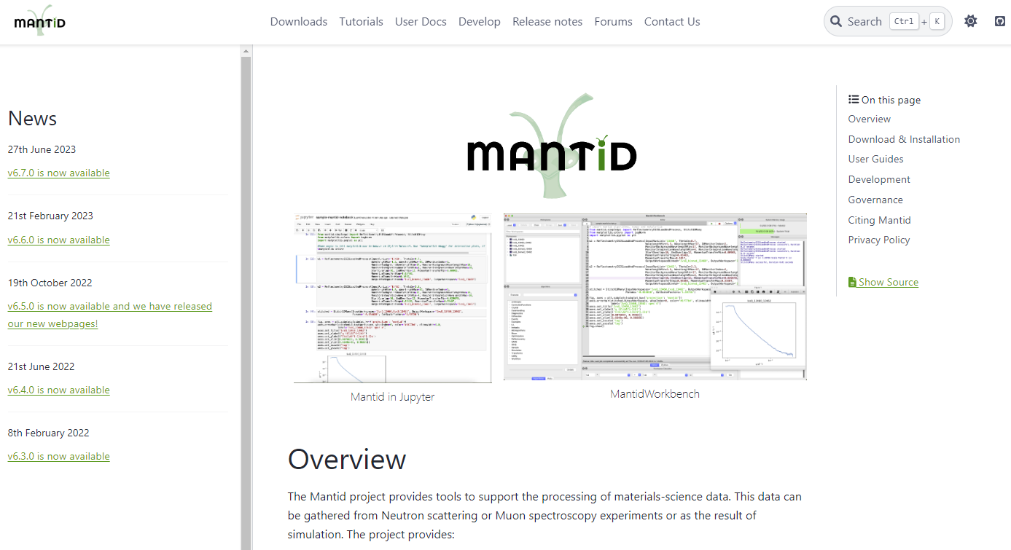
Mantid Services
Static website
User and developer documentation and downloads www.mantidproject.org
Forum
A forum for asking and answering questions related to Mantid
Jenkins
An automation server used to build, test and deploy Mantid
Error reporter
A simple Django application for collecting error reports
Usage reporter
A simple Django application for collecting usage statistics
Mailu
A mail server for managing mailing lists
2

Slide 3

Staging – why do we need it?
A Jenkins upgrade gone wrong made us realise:
• We can’t rely on Jenkins Backup & Restore
• We could easily lose all our Jenkins configuration
• Work on Mantid could come to a standstill
Motivation
We want to maintain and improve our services,
but we do not want to lose important configurations or cause disruption.
3
Notes:
They can cause severe disruption to our services if an update goes wrong
The ability to test changes and experiment within a safe environment is crucial for this
A Jenkins core update failed, and the backup system did not work
This will make maintenance of our Jenkins service easier
Here in lies the motivation for having a staging environment
Therefore we need a safe environment, identical to production, for testing our changes.

Slide 4
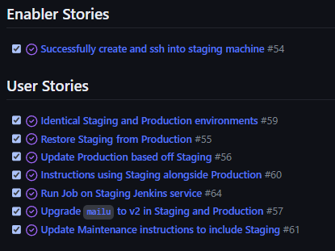
Staging – how was it implemented?
Planning
An Epic split into Stories. See Epic Hypothesis statement
Technologies
Ansible
Docker
How to use it?
Choose staging server A or B
Comment out the production certificates
Make a change, then update the staging server
a.staging-mantidproject.org OR b.staging-mantidproject.org
> ansible-playbook –i server_staging.yml playbooks/update.yml –t jenkins
4
Notes:
Epic hypothesis statement – allows you to articulate what your project is, in-scope, out of scope, and what value does the project add to Mantid as a whole Ansible is a software tool used for orchestrating services
Docker is an OS-level visualization software
Where you can change the tag depending on which service you want to update or test
Much improved documentation

Slide 5

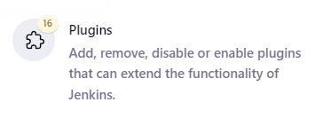


What’s next?
Done
• Mailu upgraded from v1.7 to v2.0
• Jenkins core and plugins upgraded
• Leeroy scheduling upgrade
In progress
• Continued maintenance
• Jenkins plugin review
5
Notes:
Leeroy sits between Github and Jenkins and connects up the web hooks to trigger builds on Jenkins.

Slide 6
Thank you!
6

